Slide 1
The Role Of UML In Modern Software Development
SlideMake.com

Slide 2
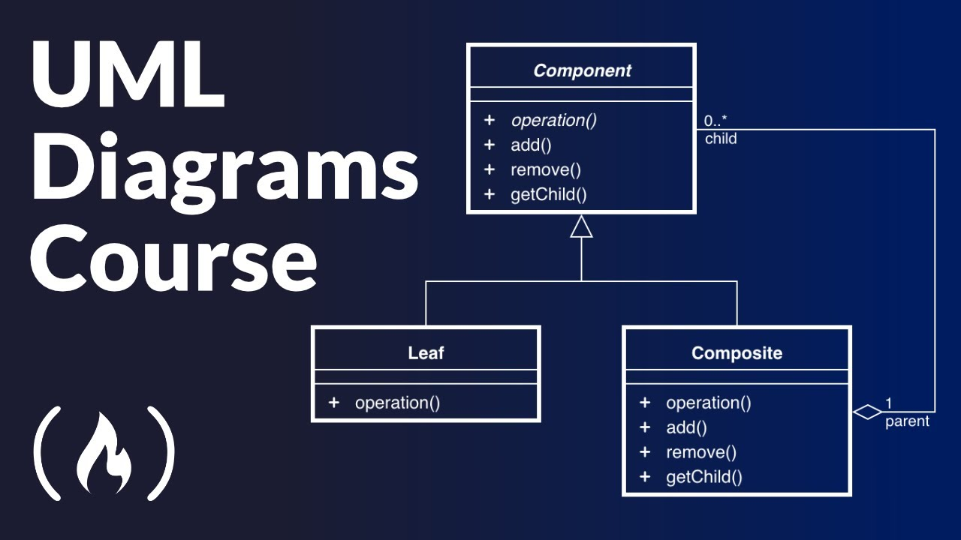
Introduction to UML
UML, or Unified Modeling Language, is a standardized modeling language used in software engineering.
It provides a way to visualize the design of a system through various diagram types.
UML serves as a bridge between the technical and non-technical stakeholders in a software project.
Notes:
Image source: https://i.ytimg.com

Slide 3
Importance of UML in Software Development
UML helps in capturing and documenting software requirements effectively.
It facilitates communication among team members by providing a common language.
Using UML can reduce misunderstandings and errors during the development process.
Notes:
Image source: https://www.crawfordnetsolutions.com

Slide 4
Types of UML Diagrams
UML includes structural diagrams, such as class and component diagrams.
Behavioral diagrams, like use case and sequence diagrams, represent interactions within the system.
Each diagram serves a unique purpose and helps in different phases of software development.
Notes:
Image source: https://www.researchgate.net

Slide 5

UML in Agile Methodologies
UML can be adapted to fit Agile methodologies by using simplified diagrams.
It enables iterative development by providing quick visual feedback on design changes.
Agile teams can use UML to maintain flexibility while still capturing essential system aspects.
Notes:
Image source: https://iwconnect.com

Slide 6
Enhancing System Design with UML
UML aids in creating a clear blueprint of the system architecture.
It assists in identifying potential design flaws before the implementation phase.
By visualizing relationships and dependencies, UML fosters better system organization.
Notes:
Image source: https://i.ytimg.com

Slide 7
UML and Code Generation
UML tools often provide features for automated code generation from diagrams.
This capability accelerates the development process and minimizes human error.
Code generated from UML can be a solid foundation for further refinement and expansion.
Notes:
Image source: https://i.ytimg.com

Slide 8
Challenges of Using UML
Despite its advantages, UML can be perceived as complex and overwhelming by some developers.
Misinterpretation of diagrams can lead to inconsistencies in the implementation.
Ensuring that UML diagrams remain updated is crucial to avoid discrepancies as the project evolves.
Notes:
Image source: https://i.ytimg.com

Slide 9
Conclusion
UML plays a pivotal role in modern software development by improving clarity and communication.
Its flexibility allows it to be integrated into various development methodologies.
As software complexity increases, the use of UML will likely continue to be relevant and beneficial.
Notes:
Image source: https://i.ytimg.com

